Slide 1

The S&P 500

Slide 2
Learning Objectives
Students completing the slide deck will:
Understand what stock market indices are and recognize some of the most commonly used stock market indices
Differentiate between price-weighted and value-weighted indices
Learn about the S&P 500 index, including how it is constructed

Slide 3








What is a Stock Market Index?
A stock market index is a hypothetical portfolio created by: (1) selecting a group of stocks that represent a particular market or industry, and (2) tracking the performance of those stocks over time.

Slide 4
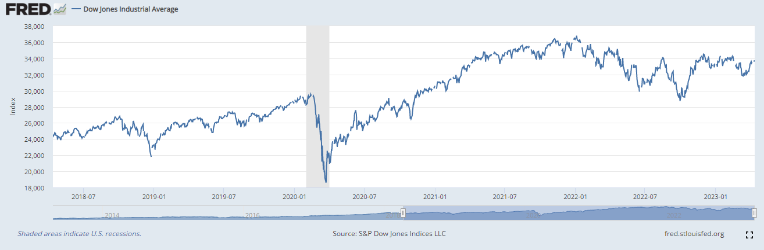
What is a Stock Market Index? (cont.)
Using a stock index, you can measure the fluctuations of a market or industry. This information may serve as an indicator of broader economic conditions.

Slide 5
What is a Stock Market Index? (cont.)
For example, this graph depicts five years of the Dow Jones Industrial Average (DJIA), a widely-watched benchmark index for U.S. blue-chip stocks.

Slide 6
What is a Stock Market Index? (cont.)
Note the sharp dip in the DJIA during early 2020.
Recall that In March of 2020, the World Health Organization declared COVID-19 a global pandemic.

Slide 7
What is a Stock Market Index? (cont.)
As benchmarks for investment performance, stock market indices are often used when estimating a specific stock's volatility relative to the overall market. This estimate is covered in other WRDS Classroom Tools such as CAPM Equity Valuation and Beta Visualization.
Price

Slide 8
What is a Stock Market Index? (cont.)
The choice of index an analyst uses as a benchmark depends on the specific market or sector that the stock operates in.
For example, if the stock is in the technology sector, the tech-heavy NASDAQ Composite may be a more appropriate index to use than the S&P 500.

Slide 9
Common Types of Stock Indices
Global
Stocks from across the globe (e.g., the MSCI World Index tracks companies in 23 developed countries)
National
Stocks from a specific country (e.g., India’s NIFTY 50)
Regional
Stocks from a particular region (e.g., Euro Stoxx 50)
Industrial
Stocks that belong to a specific industry sector (e.g., energy stocks are represented in the S&P Global Energy Index)
Exchange-based Stocks traded on one exchange or a group of exchanges (e.g., NASDAQ Composite)

Slide 10
How is a Stock Market Index Price Calculated?
An index’s price is typically calculated using a weighted average of the prices of all the stocks that make up the index.
The weightings are determined by factors such as stock price or market capitalization.

Slide 11
Price-Weighted Average
A price-weighted stock index is, at its simplest, a measure of the average price of the stocks in the index, with each stock weighted according to its individual price per share.
For example, imagine a price-weighted index holding only three stocks:
Stock A = $10 a share
Stock B = $20 a share
Stock C = $30 a share

Slide 12

Price-Weighted Average (cont.)
The simplest version of a price-weighted stock index would calculate the price of this index by adding the 3 stock prices together, then dividing by the number of stocks.
$10 + $20 + $30 = $60
$\frac{\$60}{3}$ = $20
Note that a price-weighted average means that the companies with higher-priced stock shares are given more weight in determining the overall performance of the index.

Slide 13
Price-Weighted Average (cont.)
For most price-weighted indexes, however, this divisor is adjusted; it is not simply equal to the total number of stocks.
$10 + $20 + $30 = $60
$\frac{\$60}{3}$ = $20
For example, the managers of the Dow Jones Industrial Average adjust this divisor to maintain continuity in the event of stock splits, high dividend payouts, or when there are changes to the companies that make up the index.

Slide 14
Market Value-Weighted Average
Another common weighting method used in stock market indices is to weigh larger companies more heavily. This is known as a “market-value weighted average” or “capitalization-weighted average.”
With this method, the market capitalization (or “market cap”) of each company is used as the basis for determining the stock’s weight in the index.

Slide 15
What is Market Capitalization?
Market
capitalization
Number of outstanding shares of stock
=
× Price per share
“Outstanding shares” means all the stock held by a company’s shareholders on the open market. This includes restricted shares held by a company’s officers and institutional investors. Treasury shares (which are shares of a company's stock that the company itself has bought back) are not considered outstanding shares.

Slide 16
Effect of a “Market Value-Weighted” Average
Using a market value-weighted average, companies with larger market caps are given greater weight in the index than companies with smaller market caps.
This means that the performance of the largest companies in the index has a greater impact on the overall index performance than smaller companies.

Slide 17
Calculating the Market Value-Weighted Average
Imagine an index containing only two stocks. For the total market cap, first calculate the market cap for each company, then add these values together.
Company A’s market cap $50 million
Company B’s market cap + $100 million
Total market cap = $150 million

Slide 18
Calculating the Market Value-Weighted Average (cont.)
While we are keeping this example simple, typically this total market capitalization is also adjusted by a divisor.
Just as with price-weighted average indices, the divisor is a mathematical constant used to maintain continuity in the index’s price level as companies are added or removed, as well as when stock prices change due to corporate actions such as stock splits.

Slide 19
Calculating the Market Value-Weighted Average (cont.)
After determining the total market cap, calculate each stock’s respective weight in the index by dividing each company’s market cap by the total market cap.
Company A’s stock weight = $50M/$150M = 1/3
Company B’s stock weight = $100M/$150M = 2/3

Slide 20
Calculating the Market Value-Weighted Average (cont.)
Finally, calculate the market value-weighted average by summing the product of each company's market cap and its weight.
Co. A market cap × Co. A weight $50M × 1/3 (16.67M)
+ Co. B market cap × Co. B weight + $100M × 2/3 (66.67M)
Market value-weighted Average $83.33M

Slide 21
Six Examples of Stock Market Indices
Index | Description
S&P 500 | Market capitalization-weighted index that tracks the performance of 500 stocks listed on US exchanges.
Dow Jones Industrial Average | Price-weighted index that tracks 30 large, publicly-owned companies trading on the New York Stock Exchange and the NASDAQ.
Nasdaq Composite | Market capitalization-weighted index that tracks the performance of more than 3,000 stocks listed on the NASDAQ.
Financial Times Stock Exchange (FTSE) 100 | Market capitalization-weighted index that tracks the performance of the 100 largest companies listed on the London Stock Exchange.
Nikkei 225 | Price-weighted index that tracks the performance of 225 stocks listed on the Tokyo Stock Exchange.
Russell 2000 | Market capitalization-weighted U.S. stock market index made up of the smallest 2,000 stocks in the Russell 3000 Index.

Slide 22
What is the S&P 500 Index?
The S&P 500 Index, created in 1957 by Standard and Poor’s, is a collection of 500 of the largest publicly-traded companies in the United States.
The S&P 500 includes companies from a wide range of industry sectors.
The S&P 500 provides a snapshot of the U.S. stock market and is often used as a benchmark for the overall performance or “health” of the U.S. economy.

Slide 23
What is the S&P 500 Index? (cont.)
However, while it is seen as a continuous benchmark, keep in mind the constituents of the S&P 500 have changed significantly over time. These changes reflect the shifting landscape of the U.S. economy and the stock market.
For example, when it was created the largest companies in the index were General Motors, General Electric, and ExxonMobil. Over the years, however, the index has become increasingly dominated by companies in the information technology sector.

Slide 24
How are the Largest Companies Determined?
The type of market capitalization weighing method used to create the S&P 500 Index is known as a float-adjusted market capitalization.
To calculate the float-adjusted market capitalization of a company, the total number of outstanding shares is reduced by the number of shares that are closely held by insiders or institutions and are not available for trading. This method is used to better reflect the market demand for the shares.

Slide 25
Criteria for S&P 500 Constituents
S&P Dow Jones Indices manages the S&P 500 Index, supervising the removal and addition of companies.
They publish a fact sheet explaining the criteria used to determine whether or not a company is included in the S&P 500 Index. The next two slides summarize this criteria. (If you are interested in more detailed information, an excerpt from the fact sheet is included in the Notes at the end of this slide deck.)

Slide 26
Criteria for S&P 500 Constituents (cont.)
In summary, S&P 500 Index constituents must:
Be U.S. companies
Have an unadjusted market cap ≥ $12.7B, and a float-adjusted market cap that is at least 50% of the unadjusted minimum market cap threshold
Report positive earnings over the most recent four quarters (summed together)

Slide 27











Criteria for S&P 500 Constituents (cont.)
Furthermore, industry sector representation across the whole of the index is also taken into consideration as incoming companies are chosen to replace exiting companies in the S&P 500 Index.

Slide 28
The S&P 500’s Industry Sectors
The Global Industry Classification Standard (GICS) was developed by Standard & Poor’s and is used to classify the S&P 500’s constituents by industry. The 11 industry sectors represented in the S&P 500 Index are:
Energy
Materials
Industrials
Consumer Discretionary
Consumer Staples
Health Care
Financials
Information Technology
Communication Services
Utilities
Real Estate

Slide 29
Possible Issues When Using the S&P 500 Index
Smaller companies are not included at all in the index, even if they are outperforming larger companies in the market.
Companies with the largest market capitalizations have the greatest influence on the index’s performance. A very small number of companies with huge market capitalizations can have a significant impact on the overall performance of the index.

Slide 30
Possible Issues When Using the S&P 500 Index (cont.)
Sector bias occurs when a particular sector dominates the index, meaning that sector’s performance has a disproportionate impact on the overall performance of the index.
For example, if the information technology sector is over-represented in the index, then any gains or losses in that sector will affect the overall performance of the index more than other sectors.

Slide 31
Possible Issues When Using the S&P 500 Index (cont.)
Finally, the S&P 500 only includes companies that are headquartered in the United States. These may not necessarily be the best-performing companies in the global market.

Slide 32
Link to Assignment
Click the links on the WRDS Classroom site or use the following links to complete activities related to the S&P constituents over time:
https://wrds-www.wharton.upenn.edu/classroom/sp500-introduction/
https://wrds-www.wharton.upenn.edu/classroom/sp500-introduction/over-time/ https://wrds-www.wharton.upenn.edu/classroom/sp500-introduction/year-explorer/
Your institution must have a subscription to the CRSP dataset at WRDS in order to access the activities.

Slide 33
Conclusion
A stock market index is a hypothetical portfolio created by: (1) selecting a group of stocks that represent a particular market or industry; and then (2) tracking the performance of those stocks over time.
Using a stock index, you can measure the fluctuations of a market or industry. This information may serve as an indicator of broader economic conditions.

Slide 34
Conclusion (cont.)
An index’s price is typically calculated using a weighted average of the prices of all the stocks that make up the index; weightings are determined by factors such as stock price or market capitalization.

Slide 35
Conclusion (cont.)
The S&P 500 Index is a float-adjusted market- capitalization-weighted index that tracks the performance of 500 of the largest US companies.
It includes companies from a broad range of industry sectors and is widely seen as a benchmark for the overall performance of the US economy.

Slide 36
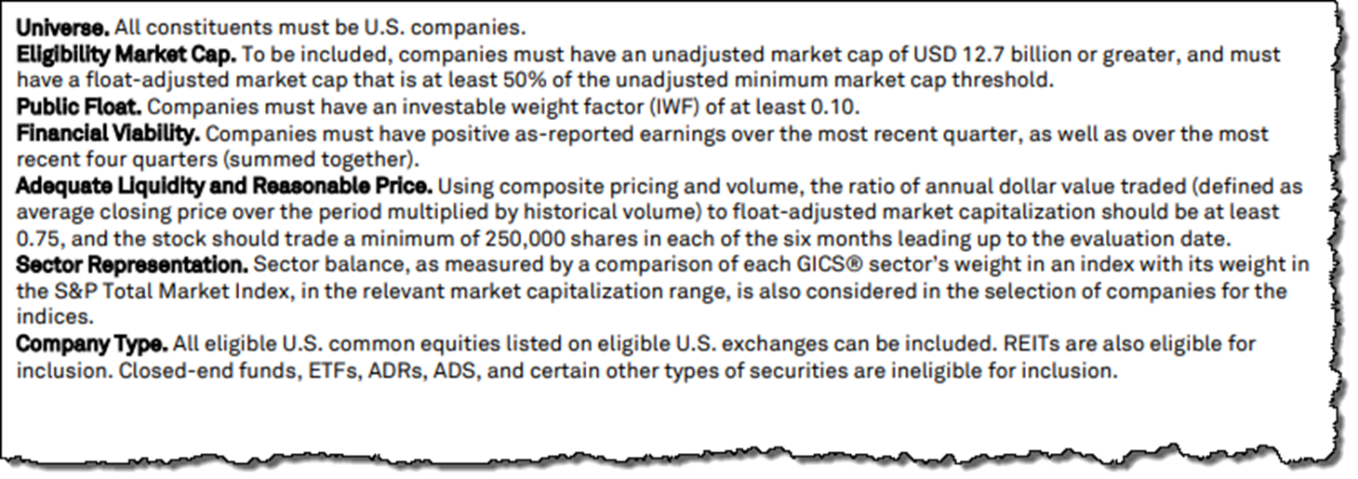
Notes
The following excerpt is from the S&P Dow Jones Indices’ fact sheet found on their S&P 500 Overview page.

